Slide 1
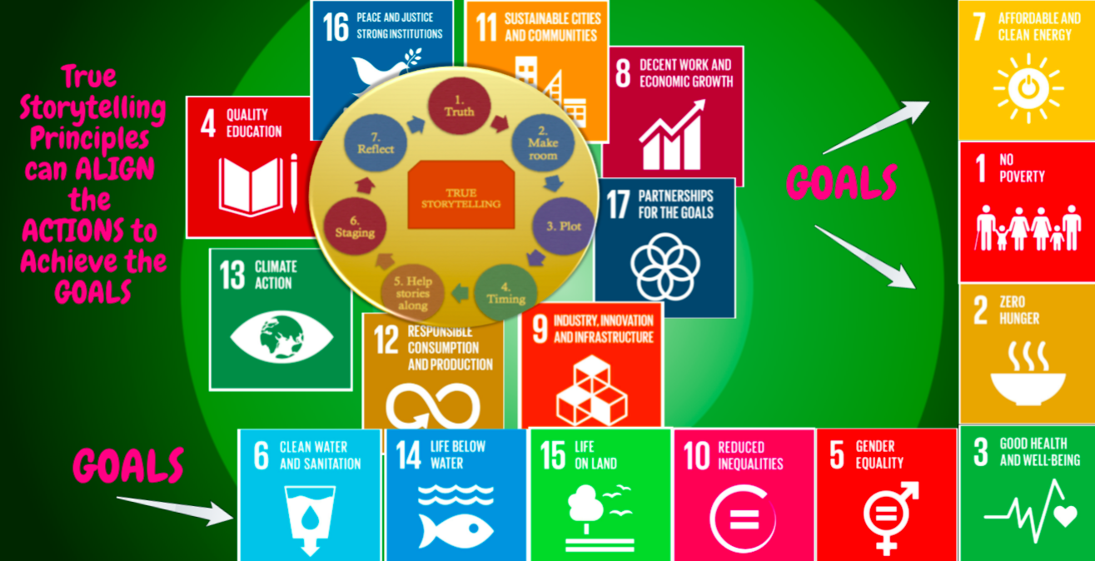
‘Distinguished Speaker’ Management Consulting Division PDW http://davidboje.com/AOM
Slides and books
Teaching SEAM Small Business Consulting: New Directions
David M. Boje, Ph.D.
Notes:
Your introductory or title slide should convey the overall “feeling” and focus of your presentation. For instance, I typically present about small-business trends, new business ideas, growth opportunities or other positive trends. In this sample presentation, I’m talking about new business ideas, so I used a sun graphic in this slide template to convey a positive feeling. Personalize this slide template with your company’s logo.
To add a logo to all slides, place it on the Slide Master. To access the Slide Master, on the Themes tab of the Ribbon, click Edit Master and then click Slide Master.
Disclaimer: You understand that Microsoft does not endorse or control the content provided in the following presentation. Microsoft provides this content to you for informational purposes only; it is not intended to be relied upon as business or financial advice. Microsoft does not guarantee or otherwise warrant the accuracy or validity of this information and encourages you to consult with a business or financial professional as appropriate.
RIEVA LESONSKY
Founder and President, GrowBiz Media
Rieva Lesonsky is founder and president of GrowBiz Media, a content and consulting company specializing in covering small businesses and entrepreneurship. A nationally known speaker and authority on entrepreneurship, Lesonsky has been covering America’s entrepreneurs for nearly 30 years. Before co-founding GrowBiz Media, Lesonsky was Editorial Director of Entrepreneur Magazine.

Slide 2
LESSON PLAN 6 STEPS
Opening Activities
Healthy Happy Terrific
The Homework Questions you will focus on
A Boal ice-breaker (with some connection to homework)
The Content
Grading last week's homework
The Slides and YouTube about the new homework
Interactive Experiential Event
Some activity in class or field trip where everyone gets involved in experiencing the material
4. A 2 Minute Pluses and Minuses (what worked well, what can improve next time
5. Scoring sheets distributed, filled out by audience
6. Boje meets with presenting time to go over scoring and assign grade; Good news presenting team does no do the homework they assigned to the class
Notes:
Why we should bulldoze the business school
How well does ACTION RESEARCH meet any scientific; measures what it sets out to & reflects the reality its theory claims to represent
https://www.theguardian.com/news/2018/apr/27/bulldoze-the-business-school

Slide 3
TODAY’S LESSON PLAN
STEP 1: Three Opening Activities
Healthy Happy Terrific
The Homework Questions you will focus on
A Boal ice-breaker (with some connection to homework)
NEXT HOMEWORK and Today’s Focus
Question 2a: What is your story of meeting a potential client?
2b: Include field notes you wrote down during the visit (observations, reflections, verbatim notes)?
I chose Boal Exercise 5 Furnish the empty space p. 142
“Two actors face to face. One moves and the other fills ‘the empty space’; if one draws back her hand, the other pulls hers in, if one shrinks, the other grows taller, etc.”
Notes:
Why we should bulldoze the business school
How well does ACTION RESEARCH meet any scientific; measures what it sets out to & reflects the reality its theory claims to represent
https://www.theguardian.com/news/2018/apr/27/bulldoze-the-business-school

Slide 4
STEP 2: THE CONTENT
Grading last week's homework
What CLIENT APPLICATIONS DO WE HAVE AND ANY CLIENTS HERE TODAY
Choose the top clients for class to organize teams around
Students become part of SEAM TEAM with a client
GRADE THE HOMEWORK FROM last class
The Slides and YouTube about the new homework
BOJE’s DAY TWO SLIDES (you are here now) see next few slides
YOUTUBE – Importance of Storytelling in Organizations https://www.youtube.com/watch?v=iUj_27aVuqw

Slide 5
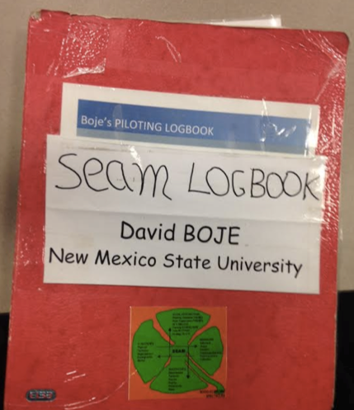
STEP 2 CONTENT: NEW DIRECTION for SEAM ➔ ROUTINES OF SMALL BUSINESS TAUGHT in SEAM to Undergraduates & MBAs
Can SEAM help routines of small business be DYNAMIC and AGILE?
Latest work on dynamic routines says routines that ACTORS perform are mediated by ACTANTS (Sele & Grand,2016) Organization Science, 27(3), 722-738)
ACTANT can be an App, software, material configuration, and the 6 SEAM TOOLS or the Material layout of a BUILDING or SHOP (Tamara)
Boje’s Piloting Logbook
Please Make SEAM Logbook YOUR TEAM’S FINAL REPORT_USE TEMPLATE

Slide 6
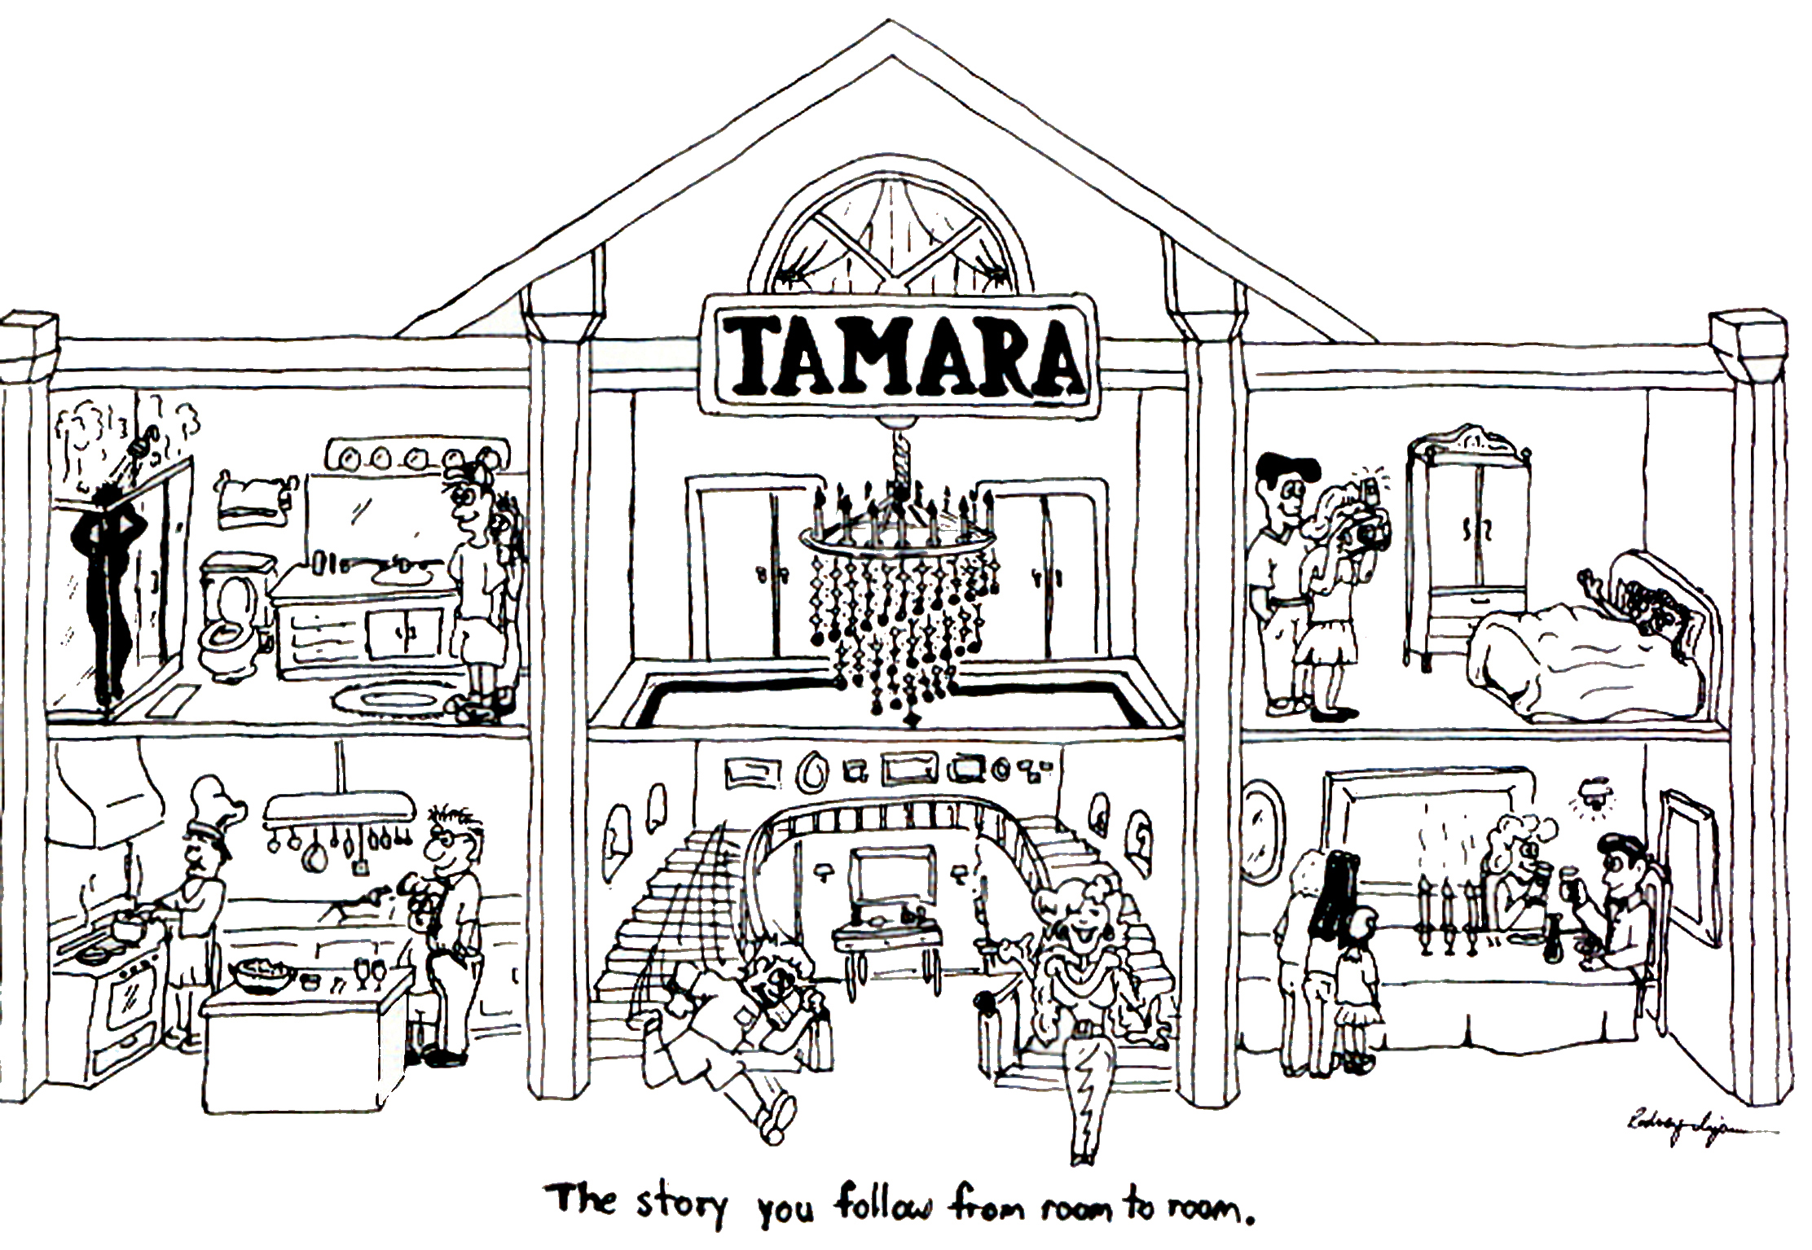
TAMARA a Material ACTANT in mediating the HUMAN ROUTINES

Slide 7
Original YouTube for today
YOUTUBE – Importance of Storytelling in Organizations https://www.youtube.com/watch?v=iUj_27aVuqw

Slide 8
SMALL BUSINESSES ARE VIRTUALIZING
Virtual SMALL BUSINESS ➔ “Temporary network of independent companies — suppliers, customers, even erstwhile rivals— linked by information technology to share skills, costs and access to one another markets”(Davis, 2016: 69).
Consumers in our dis-integrated economy have no idea what is going on in ‘SMALL BUSINESS’ Virtual supply chain
Or how [Apps & Material] ACTANTS especially the 6 SEAM TOOLS are ACTANT-mediators of Actual/Real routines that small business actors perform
➔ SMALL BUSINESS has gone global and virtual in VIRTUAL/REAL

Slide 9
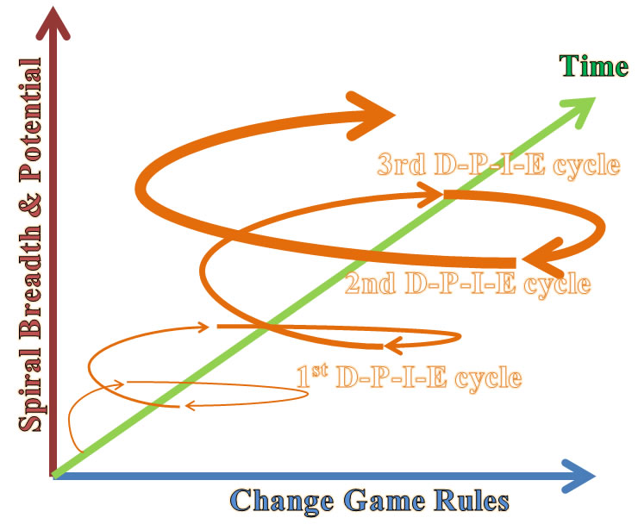
Step 2: ‘CONTENT’ the 3 DPIE’s
Notes:
Savall, Henri. (1975/2010). Work and People: An Economic Evaluation of Job-Enrichment. 1975 book "Enrichir le trail human dans les enterprises et les organizations". 2010 English version is Translated from French by M. A. Woodhall. Charlotte, NC: Information Age Publishing, Inc.
There is an important, and non-researched, double spiral that is theorized by Savall (1975/2010) which is dialectical relation between and explosive (upward) spiral and an implosive (downward) regressive {death} spiral

Slide 10
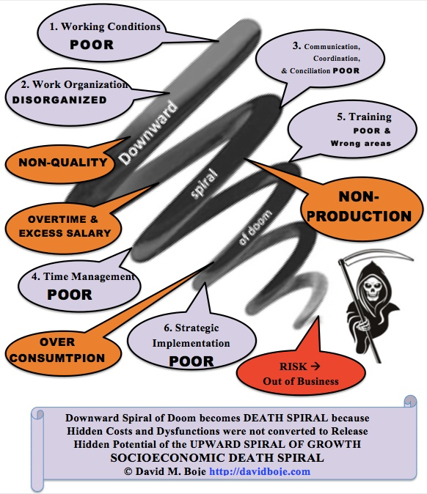

Slide 11
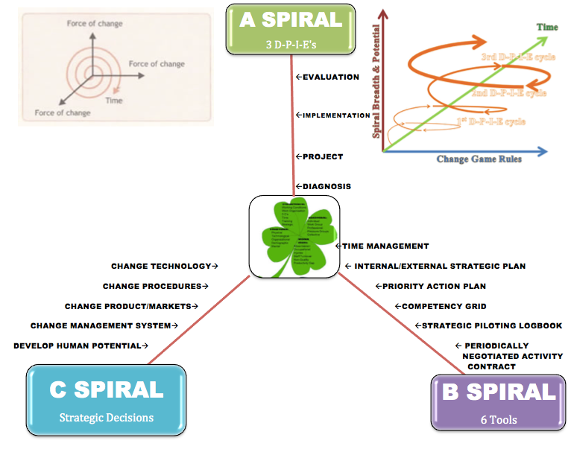
Step 2: ‘Content’: SEAM Consulting Model
6 SEAM TOOLS are ACTANTS that MEDIATE THE ACTORS’ ROUTINES ➔

Slide 12
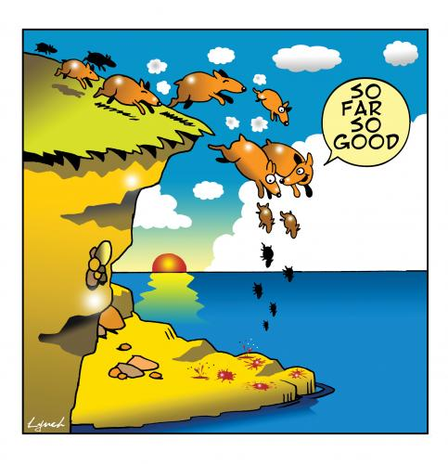
As we approach 6th Extinction

Slide 13
SEAM & TRUE STORYTELLING PRINCIPLES
SEAM is already Full of Storytelling
Pay Attention to Material Storytelling
Strategy is Storytelling
3C’s is already Storytelling
Truth: You yourself must be true and prepare the energy and effort for a sustainable future
Make room: True storytelling makes spaces respecting the stories already there
Plot: You must create stories with a clear plot creating direction and help people prioritize
Timing: You must have timing
Help stories along: You must be able to help stories on their way and be open to experiment
Staging: You must consider staging including scenography and artifacts
Reflection: You must reflect on the stories and how they create value
Notes:
I like to speak spontaneously, so I use PowerPoint as an outline to keep me on track. It’s best to keep your PowerPoint text brief, simply reinforcing key points you will talk about at more length. You can use this slide template to convey a series of steps or related points in a short format.

Slide 14
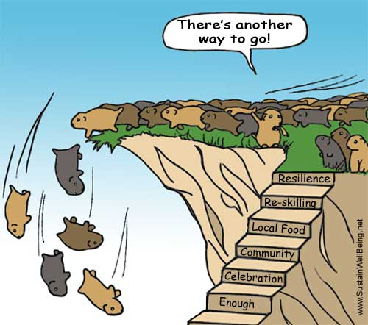
Instead of 6th Extinction
Savall is better way to go!

Slide 15
To be a SEAM Consultant:
Listen to and Observe the 'living stories’
Teach the Client 6 SEAM TOOLS as new ACTANTs
Show Client how to convert Dysfunctions & Hidden Costs into Human Potential & New Revenue Streams
Be a SEAM Team that uses ENSEMBLE LEADERSHIP

Slide 16
What is TRUE STORYTELLING now?
How to plan FUTURE?
When & Where to do PROJECT?
Reflect on OUTCOMES?

Slide 18
STEP 3: Interactive Experiential Event Some activity in experiencing the material TODAY WE Do Team From Hell CONTRACT
Step 1: Before meeting, before talking, each person write down a list: What are 3 things that drive you crazy about team work?
Step 2: Share the lists, and rank as a new team, what are the top 3. Share horror stories about each person's experience with Teams From Hell.
Step 3: Come up with a way to address each of the top 3. This can be norms that the group will enforce, giving permission to call each other out if there are norm violations, punishments that will happen (these can involve ways to make it up to the offended team members by the offending member), etc.
Step 4: Make a team contract using Step 3 and submit copy to instructor signed by everyone. Keep copy for yourselves.

Slide 19
LESSON PLAN STEP 4 (2 minutes) Q & A with class to see what worked well today, and what could be better
Write + on one side of board, and – on the other side
List the comments from the following question:
Q & A with class to see what worked well today, and what could be better

Slide 20
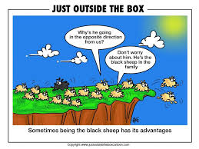
LESSON STEP 5. (5 Minutes) for scoring sheets
Presenting Team is responsible for making copies, - see Adela BC #220 in advance to get them free

Slide 21
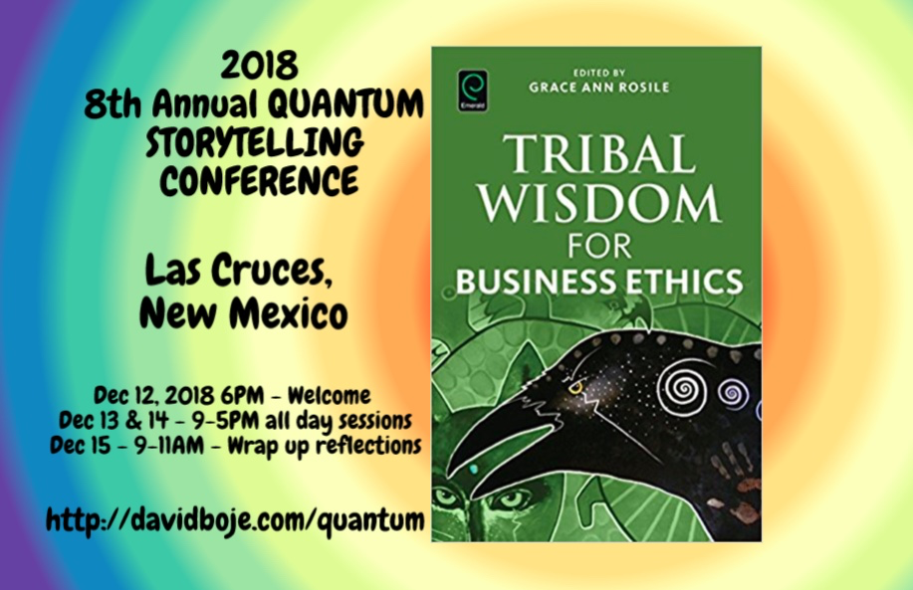
THANK YOU
Question & Answers Slides http://davidboje.com/488

